Slide 1
TASK 1
BIRUNGI JEANRITAH ROENAH.

Slide 2
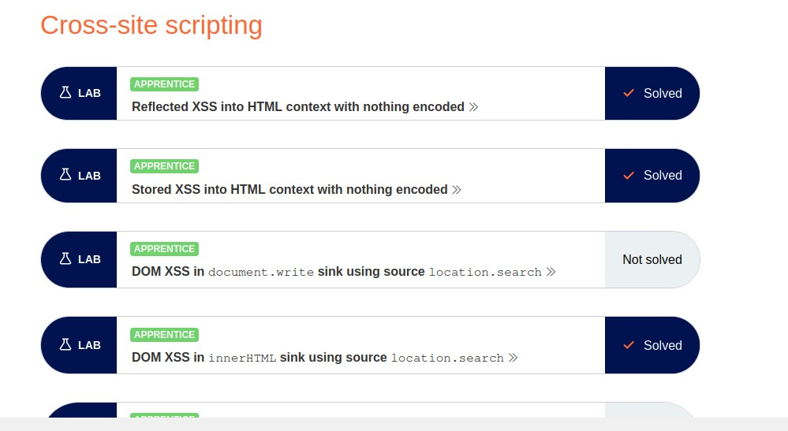
SOLVED LABS IN TASK 1. SCREENSHOT

